Slide 1
Designing a Blockchain-Driven eVault System for Legal Document Preservation
CSE7301 University Project
Review-4
Batch Number: CSE_ISR_CAP_08
Roll Number | Student Name
Under the Supervision of,
Dr. Praveena K N
Assistant Professor-Senior Scale
School of Computer Science & Engineering
Presidency University
ROLL Number | Student Name
20211ISR0034 | MADHUBALA S
20211ISR0045 | B KRIPASHINI

Slide 2
Introduction
Blockchain technology offers a reliable and decentralized approach to the storage and administration of legal records. By employing cryptographic methods and smart contracts, it ensures the integrity of data while limiting access to those who are authorized.
This addresses the weaknesses commonly found in traditional centralized storage systems, such as data breaches and unauthorized alterations. Additionally, it improves transparency and operational efficiency by reducing the need for intermediaries.
Blockchain technology offers a reliable and decentralized approach to the storage and administration of legal records. By employing cryptographic methods and smart contracts, it ensures the integrity of data while limiting access to those who are authorized. This addresses the weaknesses commonly found in traditional centralized storage systems, such as data breaches and unauthorized alterations.

Slide 3
Anticipated Advantages:
Enhanced Security:
Guarantees the safeguarding of legal documents through blockchain encryption and its unchangeable nature.
Improved Accessibility:
Enables permitted individuals to safely retrieve legal documents at any time and from any location.
Operational Efficiency:
Streamlines the verification and management of documents, minimizing manual effort and processing duration.

Slide 4
Components Required forBlockchain-Based eVault for Legal Records
1.PermissionedBlockchain Environment: Allows only verified participants to access and manage sensitive records.
2. Dedicated Node Infrastructure: Runs blockchain nodes to securely validate and store transaction data.
3. Activity Monitoring Module: Logs system operations for detailed auditing and legal oversight.
4. Instant Alert Mechanism: Notifies users of access requests, modifications, or unauthorized attempts.
5. Trusted Certificate Support: Integrates with digital certificates for document origin verification.
6. Regulatory Compliance Checker: Automatically evaluates whether processes align with legal standards.

Slide 5
7. Optimized File Handling: Uses compression techniques to manage storage efficiently for large documents.
8. Ledger Transparency Interface: Provides authorized users with access to view blockchain transaction records.
9. Secured User Session Handling: Protects login sessions with encryption, tracking, and auto-expiry features.
10. Disaster Recovery Setup: Maintains data continuity through automated backup and failover systems.

Slide 6
PROPOSED SYSTEM
System Architecture Legal documents are extremely sensitive and necessitate secure, tamper-resistant storage and regulated access.
Conventional record management systems encounter issues such as data breaches, loss, and difficulties in verification.
This initiative suggests a blockchain-based eVault system that guarantees secure storage, convenient access, and data integrity through the use of encryption, smart contracts, and decentralized technologies.

Slide 7
Work flow
Workflow The system operates in six phases:
Phase 1: User Registration & Authentication Individuals (judges, lawyers, clients) sign up and log in securely through credentials using MetaMask and private keys.
Phase2: File Upload and Encryption Legal documents are secured with AES/RSA encryption prior to storage, and metadata is hashed using SHA-256 to ensure integrity.
Phase3:BlockchainRecordCreation A smart contract is initiated to record file metadata and access logs on the blockchain ledger.
Phase 4: Decentralized Storage Encrypted documents are divided into chunks and uploaded to a decentralized storage solution (e.g., IPFS or Filecoin), guaranteeing tamper-proof preservation.
Phase 5: Access Control& Retrieval Access permissions are managed using RBAC/ABAC frameworks, permitting only authorized users to access and decrypt the records.
Phase 6: Verification and Audit Smart contracts keep a log of every access or modification attempt, facilitating traceable and auditable records.

Slide 8
IMPLEMENTATION
Encryption and Access ControlMechanisms:
Legal documents are safeguarded using AES for symmetric encryption alongside RSA for secure key distribution. To ensure file integrity, hashing with SHA-256 is employed. Access rights are governed through Role-Based Access Control (RBAC) and Attribute-Based Access Control (ABAC), which establish user permissions based on their roles and identity characteristics, ensuring that access is restricted to authorized users only.
Consensus andBlockchain Data Handling:
The system operates with Proof-of-Work (PoW) or Proof-of-Stake (PoS) algorithms depending on the specific blockchain platform to achieve agreement within the network. Merkle Trees facilitate rapid and secure data validation, while compression utilities such as zlib assist in minimizing storage space requirements without compromising data quality.

Slide 9
RESULTS
The eVault system, built on blockchain technology, was created to improve the storage, retrieval, and security of legal documents, and its effectiveness was assessed across various criteria. The use of AES for symmetric encryption and RSA for asymmetric encryption guaranteed that files remained confidential and securely protected throughout their entire lifecycle. The application of SHA-256 hashing further enhanced the system by ensuring the integrity of each stored document. During evaluations, any attempts at tampering or unauthorized alterations of data were promptly identified, showcasing the reliability of hash verification. Access control measures such as RBAC (Role-Based Access Control) and ABAC (Attribute-Based Access Control) were also effectively implemented, enabling flexible and secure management of permissions based on users’ roles and attributes. The architecture of the system demonstrated effectiveness in real-time

Slide 10
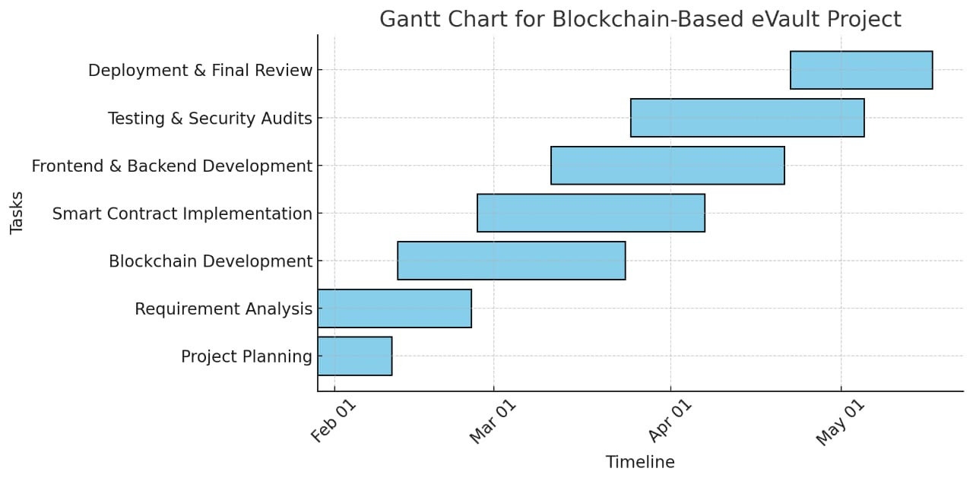
Timeline of Project

Slide 11
ALGORITHM
File Encryption Algorithm
Uses AES (Advanced Encryption Standard) for symmetric encryption and RSA (Rivest-Shamir-Adleman) for asymmetric encryption to secure file content.
Employs SHA-256 for generating file checksums to ensure data integrity.
2. Consensus and Data Management Algorithm
Blockchain consensus is achieved using Proof-of-Work (PoW) or Proof-of-Stake (PoS), depending on the selected blockchain platform.
Merkle Trees are utilized for efficient data verification and integrity checks.
3. . File Chunking Algorithm
Files are divided into smaller chunks before encryption to improve storage and retrieval efficiency.
Uses Rabin's fingerprinting algorithm to determine chunk boundaries dynamically.

Slide 12
4. Decentralized Storage Algorithms
Utilizes distributed storage protocols like Filecoin or the InterPlanetary File System (IPFS) to ensure secure and decentralized file storage.
5. Blockchain-Based Legal Record System (Built on Ganache)
Functions as a highly secure digital filing cabinet for storing crucial legal documents.
Ensures tamper-proof storage and retrieval of court documents for judges, lawyers, and clients.

Slide 13
Process of Uploading Documents to a Blockchain Network
File Selection: Users choose documents to upload via a file input window.
Metadata Extraction: The system processes the selected files and extracts relevant metadata.
Hashing and Storage:
Documents are hashed to create a unique identifier.
The hash and metadata are stored on the blockchain for verification.
Digital Signing:
Users sign documents using private keys and digital signatures to verify authenticity.
The digital signature ensures the sender’s identity without revealing document content.
Audit Logging:
The entire document exchange is recorded on the blockchain.
Audit logs ensure traceability and security, preventing data breaches or tampering.

Slide 14
Expected Outcomes
Enhanced Security & Immutability
Legal records will be tamper-proof and secure due to blockchain’s immutable nature.
Decentralized & Transparent Storage
A transparent audit trail will be maintained for legal verification and compliance.
Automated Legal Verification
Smart contracts will automate document verification, reducing dependency on intermediaries such as notaries.
Improved Legal Record Management
Role-based access (lawyers, courts, individuals) will ensure documents are accessible only to authorized users.
Regulatory Compliance & Auditability
Reduces time & costs associated with manual record-keeping and verification.

Slide 15
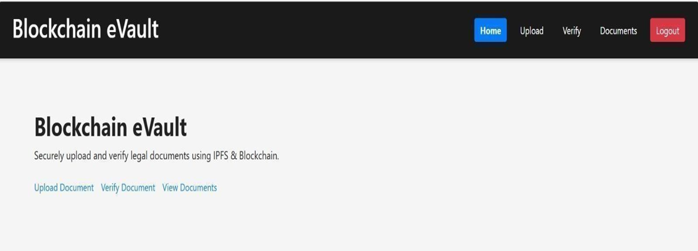
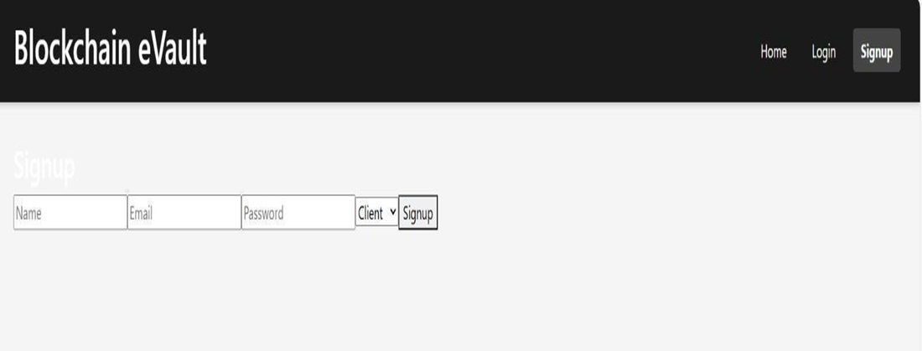
SCREEN SHOTS

Slide 16
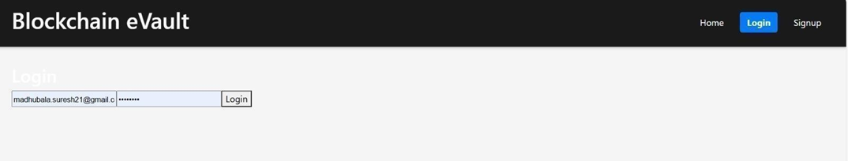
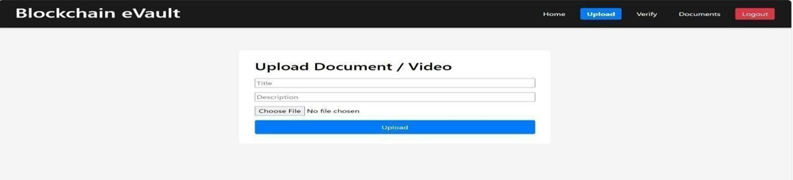

Slide 17
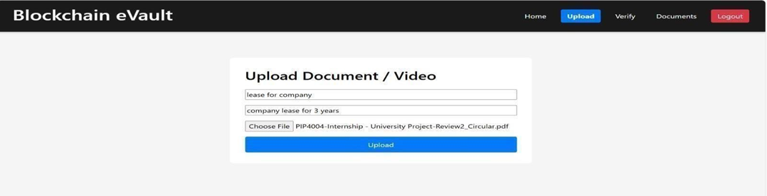
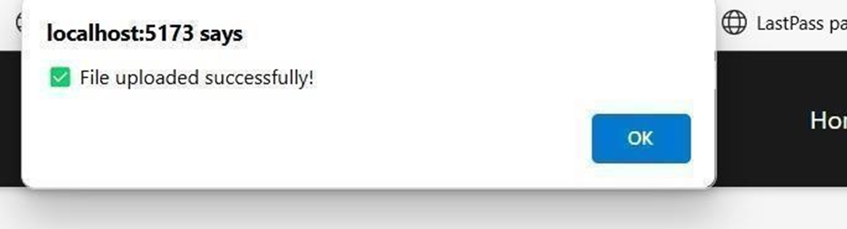

Slide 18
Conclusion
The Blockchain-Based eVault for Legal Records provides a secure, decentralized, and efficient solution for managing legal documents. By leveraging blockchain technology, smart contracts, and decentralized storage (IPFS/Filecoin), the system ensures data integrity, transparency, and security while reducing reliance on traditional centralized databases.
This approach offers several advantages, including tamper-proof document storage, automated legal verification, enhanced privacy, and cost-effective legal record management. The implementation of smart contracts eliminates the need for intermediaries, while decentralized storage prevents single points of failure.
Despite challenges such as scalability and regulatory compliance, this system has the potential to revolutionize the legal industry by improving the efficiency, security, and accessibility of legal records. Future developments could include integration with government systems, AI-powered legal analysis, and wider adoption across legal and corporate sectors.

Slide 19
References
https://www.jetir.org/papers/JETIR2406864.pdf
https://www.mdpi.com/2073-431X/10/11/135
https://www.researchgate.net/publication/329489346_CRAB_Blockchain_Based_Criminal_Record_Management_System?utm_source=chatgpt.com
https://ieeexplore.ieee.org/stamp/stamp.jsp?arnumber=10026822
https://appliednetsci.springeropen.com/articles/10.1007/s41109-020-00256-4
https://www.researchgate.net/publication/221103834_Secure_data_deduplication
https://www.mdpi.com/1911-8074/16/8/360
https://www.researchgate.net/publication/351395864_Blockchain_Law_A_New_Beginning
https://armaedfoundation.org/wp-content/uploads/2021/06/AIEF-Research-Paper-Blockchain-Technology-Recordkeeping.pdf
https://www.sciencedirect.com/science/article/pii/S0167404820302832

Slide 20
Thank You

